Slide 1
6. Management of Healthcare service
Lecturer: Chim Bunthoeurn
Sous Monysathya
Sauchhinsun Harry
Khorn Chamra
Tan Bunan
Tong Banly
Por Chetra
Kimthun Bunly
Kea Revin

Slide 2
Content
Introduction
Problem Description
Technology
Database Design
Form Design
Java Application Development
Demo Software

Slide 3
1. Introduction
Planning

Slide 4
2. Problem Description
Decision support systems are all about helping managers making a decision that is heavily supported by the data collected, past experiences, etc. Often, decision support systems are based on more than one database. This allows for integration of more data, and it results in a better decision-making process. Integrating different databases, however, is not an easy task. For example, although very critical, there are cases where the databases at clinics and insurance companies are not integrated. This lack of integration has a twofold effect:
insurance companies find it difficult to design or negotiate health care programs; and
practitioners are unable to take advantage of or participate in designing insurance programs.
The aim of this project is to design a decision support system that will integrate the data stored in different insurance companies and health care providers. The objective is to provide supporting information to the participants to make the right decision about insurance programs.

Slide 5
3. Technology
Programming Language: Java
Integrate Development Environment : NetBeans IDE 8.2
Database: SQL Server
Other: GitHub

Slide 6
Database Design
Disease
1
Work for
Is cured by
M
Doctor
1
M
1
M
M
1
Treat
1
M
1
1
Visit
M
HealthCare Provider
M
has
1
1
1
Patient
1
1
M
M
M
Premium
1
Cooperate
Insurance Company
M
1
1
M
1
1
1
Transaction
1
M
Has
1
Healthcare Plan
M
M
1
1
1

Slide 7
5. Form Design
Login and Register
Data Entry
Healthcare Provider
Search ( Disease )
Doctor
Patient

Slide 8
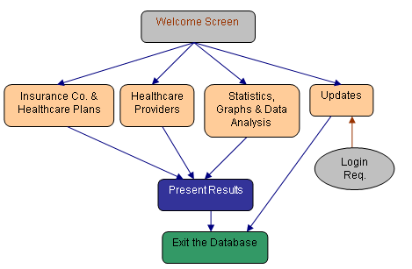
6. Java Application Development

Slide 9
7. Demo Software

Slide 10
Thank you

